Slide 1
Applied Micro Methods
Instrumental Variables

Slide 2
Overview: 3 Methods Used by Reduced-Form Applied Micro Researchers
Regression Discontinuity Design
Instrumental Variables
Difference-in-Difference
Today: Instrumental Variables
Motivation: To isolate “as-good-as-random” variation in a treatment variable

Slide 3
Example:
Crime = b0 + b1Police + b2X + e
Problem: Police variable is endogenous
Practically speaking: we can’t rule out reverse causation, or even omitted variables
Note: Detroit has twice the police per capita of Omaha, and four times the violent crime rate. Do you really think that police cause an increase in crime?
Solution: Find as-good-as-random variation in Police, the endogenous variable
Options:
i) Regression Discontinuity Design – how would that work?
ii) Find a suitable instrument

Slide 4
What must be true of a suitable instrument?
Instrument must be correlated with the endogenous variable (relevance condition)
Empirical Test: Regress endogenous variable on instrument, plus all of the controls from the main outcome specification
Rule of thumb: The F-statistic must be over 10, or you have to worry about the implications of having a “weak” instrument (if you are willing to accept bias that is no more than 10% of bias from OLS)
If you are willing to accept bias up to 20% of OLS bias, threshold is F>6.5
(source: Staiger & Stock)

Slide 5
What must be true of a suitable instrument?
2) Instrument must be uncorrelated with the error term in the properly specified equation (validity assumption, or the exclusion restriction)
Put differently, 2 says:
The only effect the instrument can have on the outcome variable is through its effect on the endogenous variable (at least once we condition on other stuff…)
Back to the crime example. Suppose we propose median family income as an instrument. We need:
Median family income to be correlated with police per capita
ii) The only effect family income can have on crime is through its effect on the level of policing

Slide 6
Levitt solution: Use electoral cycles as an instrument for police
(note: data are a panel of 59 large US cities, estimated in first-differences)
Intuition/theory: Incumbent politicians are shameless creatures who will temporarily boost policing in order to gain popularity just prior to elections
Relevance condition: It’s a nice theory, but are electoral cycles really correlated with policing?

Slide 7
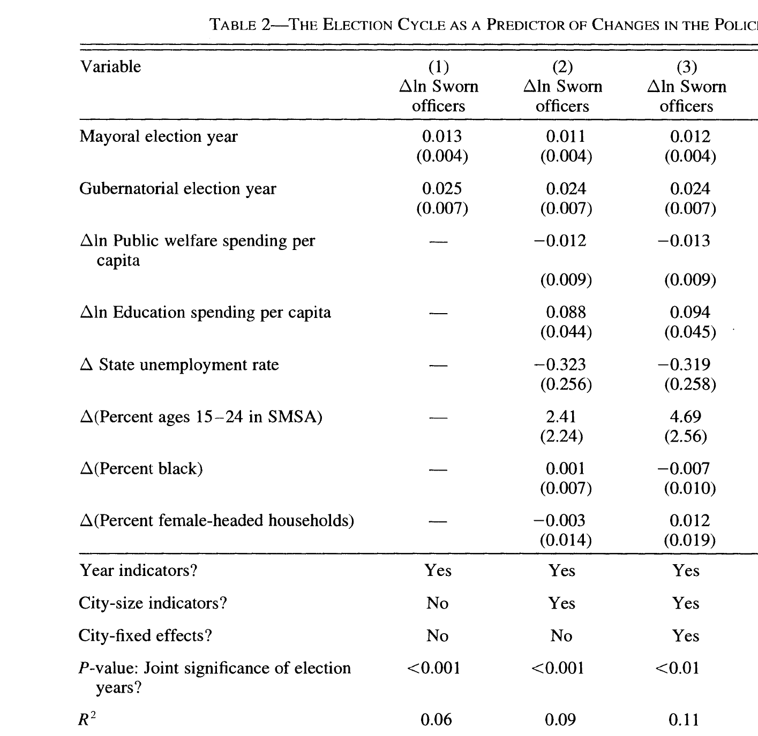
Notes:
What tables should you provide in your paper when implementing IV?
Table 1: Summary statistics
Table 2: First stage
Table 3: Reduced-form IV

Slide 8
Assessing validity: Could electoral cycles have their own independent effect on crime?
Example:
-Maybe politicians also shamelessly increase social spending, etc., for the same reason, and those things could affect crime
Solution: Control for welfare spending, etc.
Note: This is not ideal!! Ideally we would have an as-good-as-random IV that could not plausibly affect the outcome in any other way than through the endogenous variable

Slide 9
If we have both a relevant and valid IV, how do we go about estimation?
Option 1: Estimate with 2SLS
  Let Z be your set of instruments, and let Y₂ be your endogenous variable
  Main equation: Y₁=B₀ + B₁Y₂ + B₃X + e
  1st stage: Y₂ = b₁+b₂Z + b₃X + e
  (Exclusion restriction: Z does not belong in the main equation, but it does belong in the 1st stage equation)
  2nd Stage: Y₁ = B₀ + B₁Y₂hat + B₃X + e
  Note #1: if you literally plug in fitted values and estimate, you need to adjust standard errors to get right, as you have a random variable on RHS
  Note #2: You need to have at least as many instruments as you have endogenous regressors

Slide 10
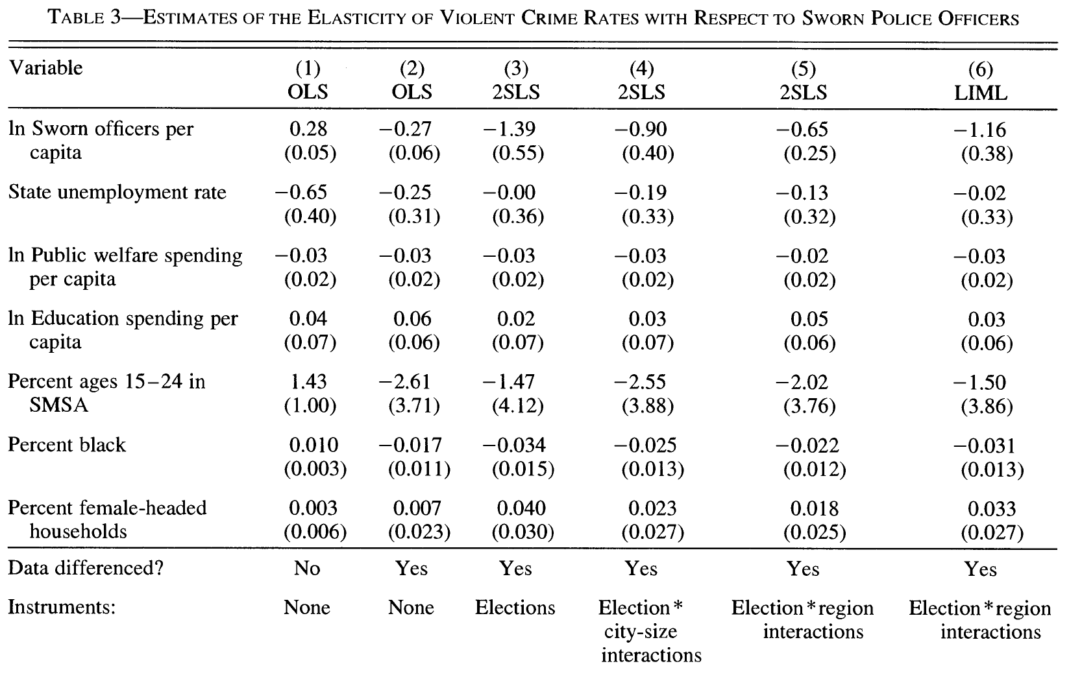
2SLS Estimates (columns 3 – 5)

Slide 11
2SLS
Advantages:
-Yields easy-to-interpret estimated effect of the independent variable-of- interest on the outcome
-Under identifying assumptions, 2SLS estimates are consistent
i.e., as sample gets large, estimates converge to “truth”
Disadvantages:
-2SLS estimator has larger standard errors than OLS (10x in Levitt’s case)
intuition: you’re only using part of the variation in the endogenous variable (hopefully an exogenous part!), not all of it
-2SLS estimator is subject to finite sample bias; biased toward inconsistent OLS estimator

Slide 12
If we have both a relevant and valid IV, how do we go about estimation?
Option 2: Estimate the reduced form IV equation
  Replace the endogenous variable with the instrument
  Levitt’s case:
  Crime = b₀ + b₁electoral cycles + b₂X + e
  Note: the endogenous variable is nowhere to be found in the equation

Slide 13
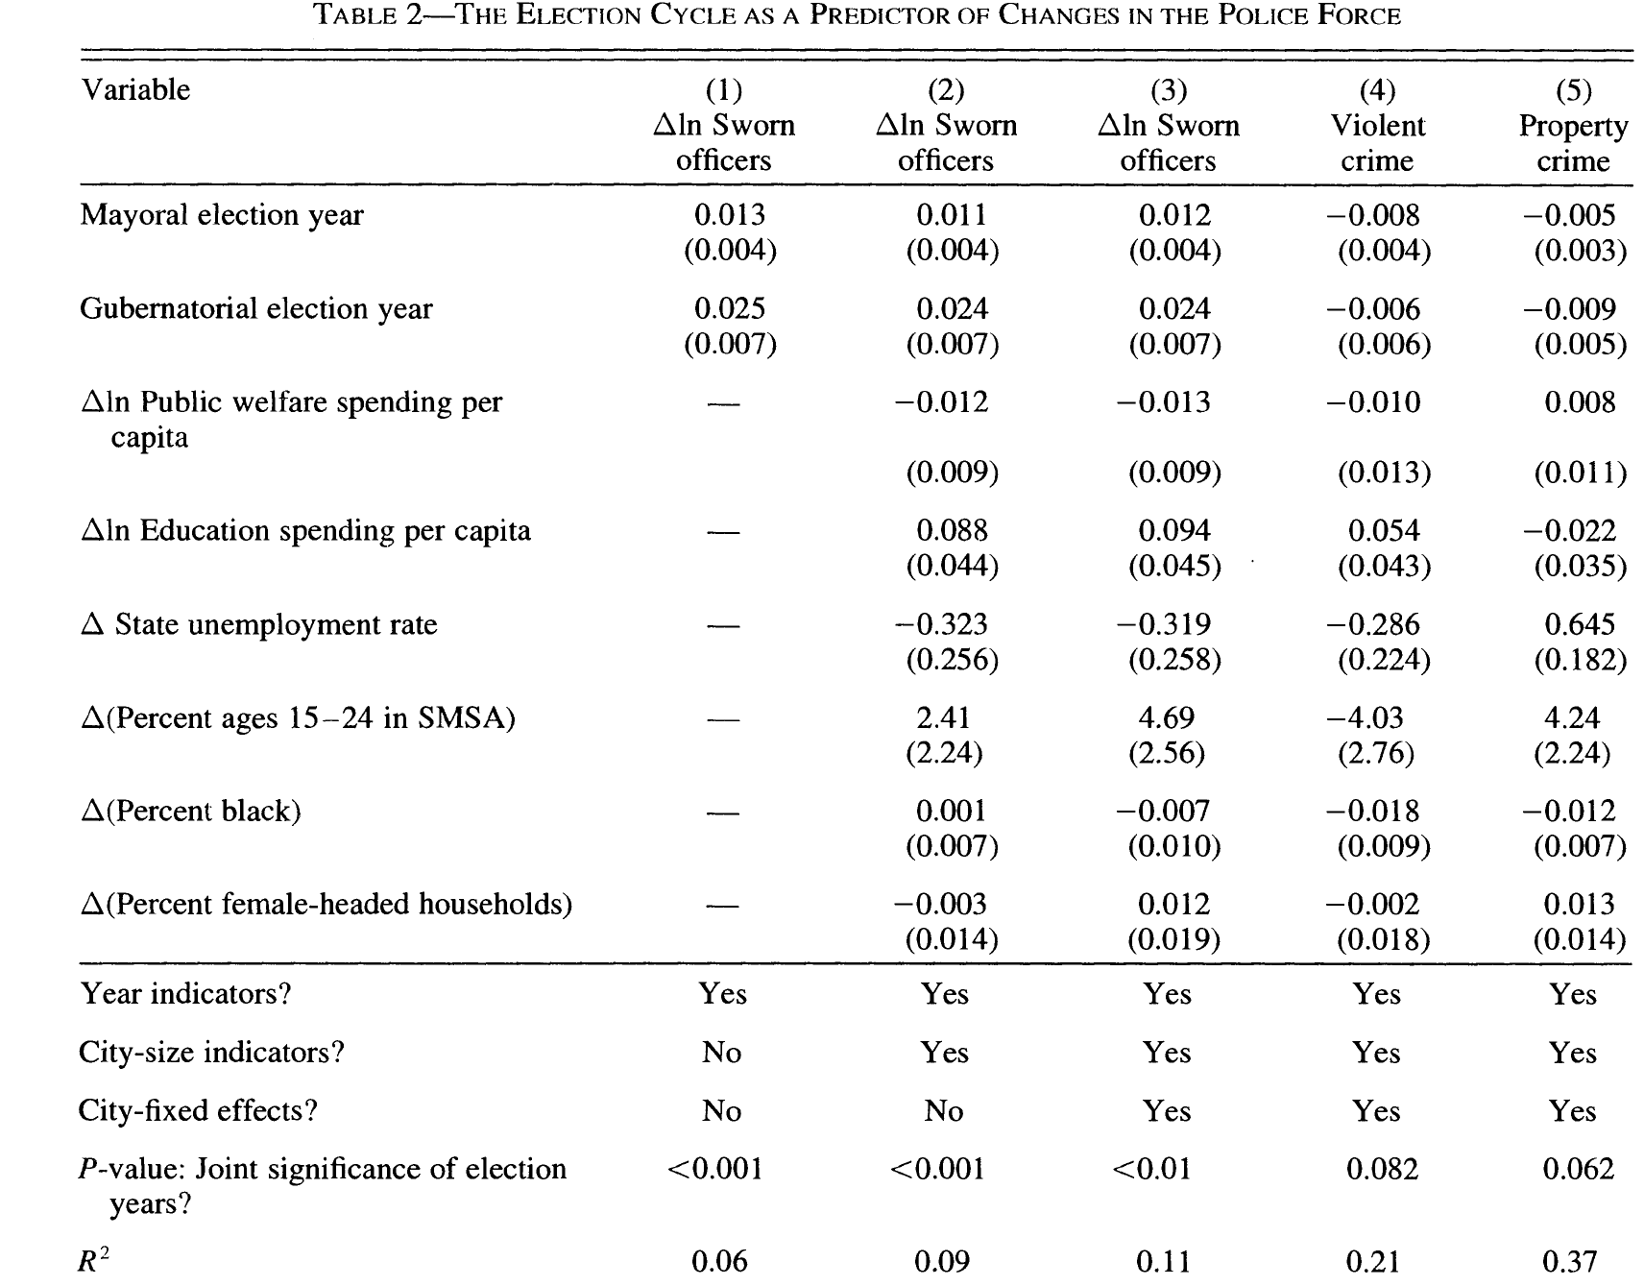
Reduced form IV – Columns 4 and 5

Slide 14
  Disadvantage of reduced-form IV estimation:
  -Interpretation isn’t as simple as it is with 2SLS; what is the causal effect of a 10% increase in the size of the police force on crime?

Slide 15
  Advantages of reduced-form IV approach:
  -OLS estimates are unbiased, even in finite samples!
  -If the measure of the endogenous variable you have is a proxy rather than the complete/ideal measure, reduced-form IV estimation allows you to avoid assuming that the only effect of the IV is through that exact proxy variable
  Example: Peer Effects at USAFA…
  Ideal equation: Fitness_{i} = B0 + B1PeerFitness_{i} + B2X_{i} + u
  Where PeerFitness is a measure of propensity to be fit, fitness habits, diet, beliefs, etc., but we don’t actually observe this measure, instead observing PeerFitnessScore
  Problems (for either specificaton):
  i) Potential for reverse causation (my fitness affects my peers’ fitness)
  ii) C causes A&B: We’re peers because we’re in the same dorm (or squadron), which is right next to the dining hall => we eat more
  iii) C causes A&B (Selection): we choose to be friends because we share the same propensity to diet, or work out
  Solution: We rule out iii) using random assignment of peers to squadrons, but that doesn’t help with i) or ii)
  Rest of the solution: instrument for current peer fitness with HS peer fitness
Notes:
I’m not completely sure about how to think about this econometrics-wise, but I am sure the conclusion is correct

Slide 16
  Two estimation options:
  2SLS (with data we have):
  1st stage: PeerFitnessScore_{i} = b₀ + b₁HSPeerFitness_{i} + b₂X_{i} + e_{i}
  2nd stage: Fitness_{i} = B₀ + B₁PeerFitnessScoreHat_{i} + B₂X_{i} + e_{i}
  Resulting Interpretation: A 10% increase in peer college fitness score causes a 3% increase in own college fitness
  Problem: Are we willing to say that the ONLY effect that peer high school fitness has on own college fitness is through the peers’ fitness score in college, which is an imperfect measure of PeerFitness?
  My assertion: HSPeerFitness is uncorrelated with the error term in:
  Fitnessi = B0 + B1 PeerFitnessi + B2Xi + ui
  But: HSPeerFitness is not uncorrelated with the error term in:
  Fitnessi = B0 + B1 PeerFitnessScorei +B2Xi +ui

Slide 17
  Solution:
  2) Reduced-form IV:
  Fitness_{i} = B₀ + B₁HSPeerFitness_{i} + B₂X_{i} + e_{i}
  Assertion(with confidence!): HSPeerFitness is uncorrelated with the error term
  Interpretation: Being around people who were 10% more fit in high school improves your own college fitness by 3%

Slide 18
Issues in IV
IV as a solution to measurement error on RHS
Recall: What is the impact of classical measurement error on LHS?
Estimator is inefficient, but not biased (i.e., your standard errors are too big)
What is the impact of measurement error on the RHS? Example:
Y = b0 + b1treatment + b2X + e
If treatment is measured with (classical) error, what is the implication?
b1 is attenuated (i.e., biased toward zero)
Solution? Find an IV for treatment, and proceed as you would for any other IV application
Intuition: IV isolates the correctly-measured variation in the treatment variable

Slide 19
Issues in IV
2. Exclusion Restriction via Functional Form Restrictions
Example from Cameron & Trivedi: y = b₁+b₂x + b₃v + e
Suppose that v is endogenous => OLS is inconsistent
Instrument for v using x².
Why should this work:
Since x is uncorrelated with e, then so should be x², satisfying the exclusion restriction
So, as long as x² is correlated with v (and determinants of an outcome often are correlated with each other), then we satisfy both conditions
Problem #1: This depends crucially on the assumption that x only enters the model linearly and not quadratically: What are the chances of that?
Problem #2: What is the thought experiment for how this is being identified here?
My advice: Don’t rely on functional form restrictions to satisfy exclusion restrictions

Slide 20
Issues in IV
3. Weak Instruments: Problems
i) Finite sample bias is more pronounced when the instruments are weak (Bound et al., 1995)
ii) Standard errors can also be very biased (Nelson and Startz, 1990)
What to do?
Fancy solution: Read the econometrics literature and apply diagnoses and potential fixes
Additionally:
i) make sure you see the 2SLS result in the reduced-form IV result
“If you can’t see the causal relationship in the reduced-form, it’s probably not there” (Angrist & Pischke, 2008)
ii) Make sure your instruments are 100% valid: Weak instruments with even very mild endogeneity can lead to IV estimates that are much more inconsistent than OLS estimates (Cameron & Trivedi)
iii) Limit the number of instruments used: more instruments => more finite sample bias
Angrist & Pischke: Show just-identified estimates, which are median-unbiased, or use Limited Information Maximum Likelihood (less efficient, but less biased) and hope for similar results
iv) Make sure you have enough strong instruments to cover endogenous variables

Slide 21
Issues in IV
3. Weak Instruments: Problems
i) Finite sample bias is more pronounced when the instruments are weak (Bound et al., 1995)
ii) Standard errors can also be very biased (Nelson and Startz, 1990)
What to do?
Simple solution: Find a strong instrument!

Slide 22
Issues in IV
4. Non-linear first and second stages
First stage: What if the endogenous variable is a dummy variable? Should you use logit or probit?
Answer: No, resulting estimates will be inconsistent unless first stage is specified exactly right
Second stage: What if the outcome of interest is a dummy variable? Should you use a non-linear second stage?
Answer: No; you’d need a correctly specified functional form to interpret estimates
Punch line: When it comes to IV estimation, use reduced-form IV and 2SLS and avoid the nonlinear stuff. If the outcome of interest is a dummy variable, then use a linear probability model.

Slide 23
Issues in IV
5. Lagged values as instruments
Exclusion restriction: Do you really believe that the only effect a lagged value has on the outcome is through the current value?
Punch line: Don’t do it!

Slide 24
Issues in IV
Multiple Instruments and Over-Identification Tests
Intuition: If you have enough “good” instruments to identify the model, then you can add other instruments to the model and test whether they appear to have their own independent effect on the outcome
Two notes:
Assuming you have enough “good” instruments is a nontrivial assumption, especially if the instruments are all related
Failing to reject the null hypothesis that the instruments are valid is NOT the same as proving that they are valid
Punch line: It probably doesn’t hurt, but it’s no substitute for a compelling story (and perhaps clever tests) as to why your IV isolates the as-good-as-random variation in the endogenous variable

Slide 25
How-To Handbook for IV Estimation
Estimate treatment effect using OLS, noting endogeneity
Use theory, intuition, and empirical tests (if possible) to convince the reader that your instrument is valid
Show the first stage, demonstrating that your instrument is relevant and not subject to the problems of weak instruments
Show results the reduced-form IV estimation (i.e., in the outcome equation/2nd stage, replace the endogenous variable with the instrument)
Show results from 2SLS (optional depending on the context)
Explain why IV estimates differ from OLS estimates

Slide 26
IV Estimation, Part II: Examples
Example 1: Stinebrickner & Stinebricker (2003)
Question: What is the effect of working during college on academic performance?
Naïve approach:
Grade_{i} = b0 + b1*weekly_hours_worked_{i} + b2*X_{i} + e
Why might you expect b1 to be biased downward (i.e., “too negative)?
e.g., students from unobservedly disadvantaged backgrounds may have to work during school, and may struggle academically)
Example: Suppose that the true b1=-0.1
=> every additional hour of work per week reduces GPA by 0.1
One possibility:
Estimate = true effect (-0.1) + effect of being from disadvantaged background that is correlated with working (say, -0.2)
= -0.3 (too negative!)

Slide 27
Why might you expect b1 to be biased upward? (i.e., “too positive”)
e.g., suppose that students who are motivated (in unobserved ways) both choose to work more, and do better at school
Estimate = true effect (say, -0.1) + effect of being motivated that is correlated with working more and achieving better grades (say, 0.2)
= 0.1 (too positive!)
Conclusion: A priori, it is difficult to know if this cross-sectional estimate will be biased upward or downward

Slide 28
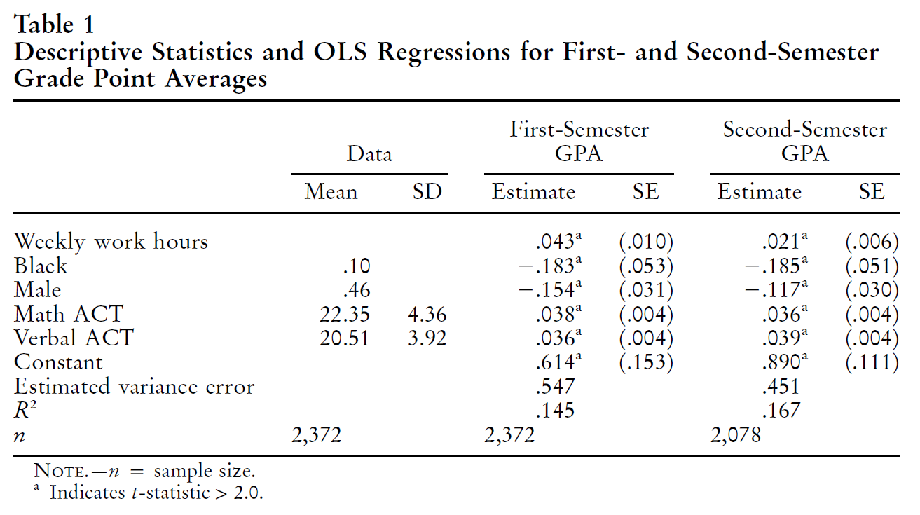
Evidence from Stinebrickner & Stinebrickner:
Causal Interpretation: Working an additional hour raises student GPA by between 0.021 and 0.043

Slide 29
What about a difference-in-difference estimator?
Intuition: Compare grades in semesters when working many hours to grades in semesters when working fewer hours, within student
Identifying assumption: Students who increase their hours of work from one semester to the next would have otherwise had the same change in grades as those who did not increase their hours
How to estimate: Using a panel of individual-level data, include student fixed effects
Would you expect bias?
Yes, estimate will probably be biased upward (i.e., “too positive”)
Example:
Estimate = true effect (say, -0.1) + effect of having an especially light academic workload, which enables more “real” hours of work (say, +0.1)
= 0, which is biased upward/too positive!

Slide 30
Evidence from Stinebricker & Stinebricker:
Estimate from individual fixed effect regressions using first two semesters:
= 0.010 (se=0.006)
Not significant, but is it still biased upward?

Slide 31
Solution? Find an instrument
Stinebrickner & Stinebricker propose initial job assignment type at Berea College
Background: Everyone at Berea College works as part of receiving full-tuition scholarships; pay is only $2/hour
Mean hours worked per week = 10.97; standard deviation = 1.40 (min = 10)
Intuition of IV: In the first semester, some students are assigned to jobs that induce students to work more hours, while others are assigned to jobs that induce fewer hours
Job categories:
Janitor; Hotel; Craft; Library; Audio; Other

Slide 32
Does the IV meet the two conditions?
(Validity/Exclusion Restriction) Job Assignment Type must only affect grades through the number of hours worked/uncorrelated with error term
(Relevance) Job Assignment Type must be correlated with hours worked in the 1st semester
Assess the validity assumption: What would cause problems?
If students are initially sorted into job type on the basis of unobserved characteristics (motivation, ability, etc.)
If jobs that require more hours are systematically different in how mentally or physically exhausting they are, or in whether students can study on-the-job, etc.

Slide 33
On Instrument Validity: The Institutional Details of Berea College Job Assignment
“The official policy of Berea College is to not sort students into jobs on the basis of academic ability, and, except for a very small number of first-year positions that are perhaps not truly of “service” nature, the college has no incentive to deviate from this policy.”
What are the exceptions?
“Specifically, we had in mind the small number of positions in the audio-visual department, which is the only labor department that we have ever heard of that may receive a nonrandom selection of students.”
“Workers in the audio-visual department are responsible for handling expensive and technically advanced equipment. Using this as a rationale, the audiovisual department (during our sample period) petitioned for workers of higher ability. We know of no other case where this took place (nor of other first-year jobs where a similar rationale would be present).”

Slide 34
But: students are asked to rank their preference for the three most common jobs: hotel, janitor, and crafts
A subset of students is randomly selected and assigned to first-year jobs other than hotel, janitor, and crafts
Remaining students: college tries to take preferences into account

Slide 35
In noting that there is the potential for selection here, the authors wisely remind reader of what it takes to cause problems:
“However, it is important to stress that, in order for this to be problematic, it would have to be the case that students with high levels of unobserved motivation/ability prefer particular jobs within this group, while individuals with low levels of unobserved motivation/ability prefer other jobs. Given the well-advertised service nature of the first-year hotel, janitor, and crafts jobs, there does not seem to be any reason to believe that this type of selection would be problematic.”
In addition, they make it clear exactly what the reader must believe for this selection to bias their IV estimates in the direction of their results
“Further, as we will see later, in order for our IV results to be explained by this type of sorting, it would have to be the case that, for example, individuals with high levels of unobserved academic ability or motivation are more likely than other students to prefer the janitor job and less likely to prefer the hotel job. Intuitively, this seems particularly unappealing, and the alternative scenario would tend to imply that our IV results are somewhat conservative.”

Slide 36
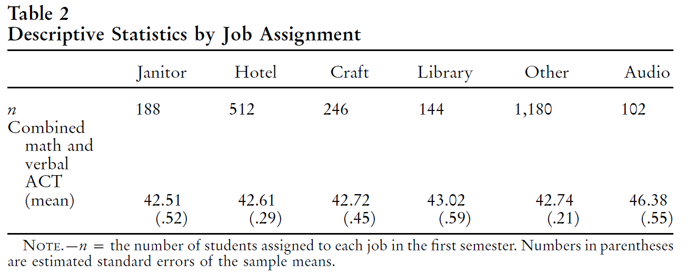
Trust, but Verify!!!!!
Conclusion: ACT scores don’t appear to be much different, except (maybe) Audio
Small Criticism: Since audio doesn’t appear to be randomly assigned, it’d be best to estimate results without audio, at least as a robustness check
(but: it’s doubtful it would matter, as Audio isn’t a job type that appears to drive variation in hours…)

Slide 37
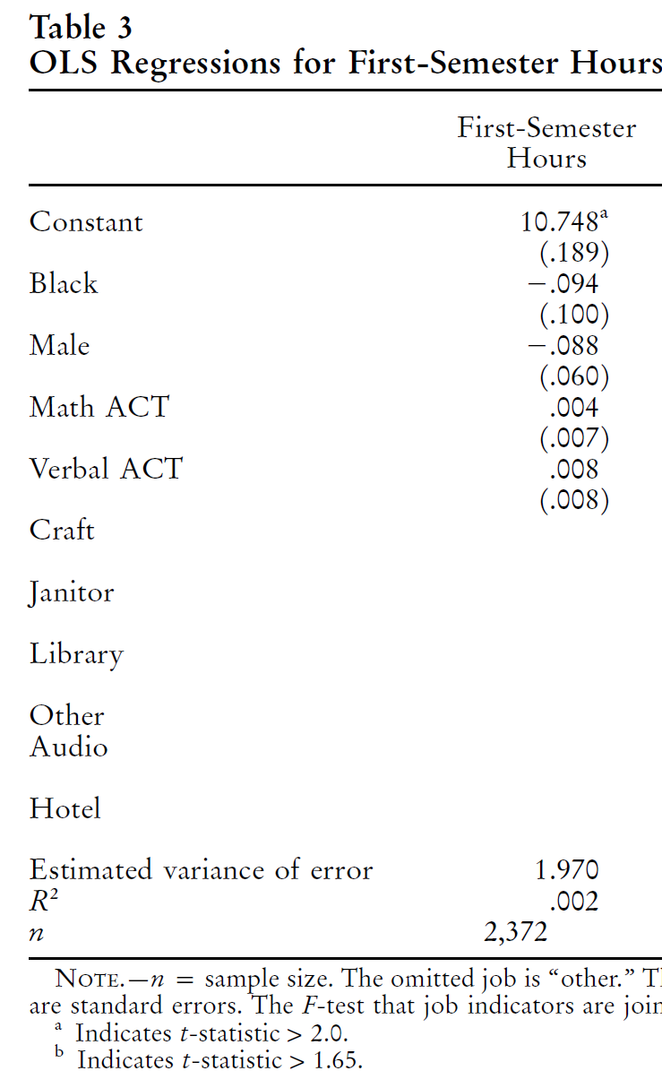
Note: None of the coefficients on
covariates are statistically significant
Further noted in the text:
F = 1.61; cannot reject null that
coefficients are jointly equal to zero
Punch line: It doesn’t look like
hours are predicted by individual
characteristics
Question: why use hours as dependent
variable, and not job type?

Slide 38
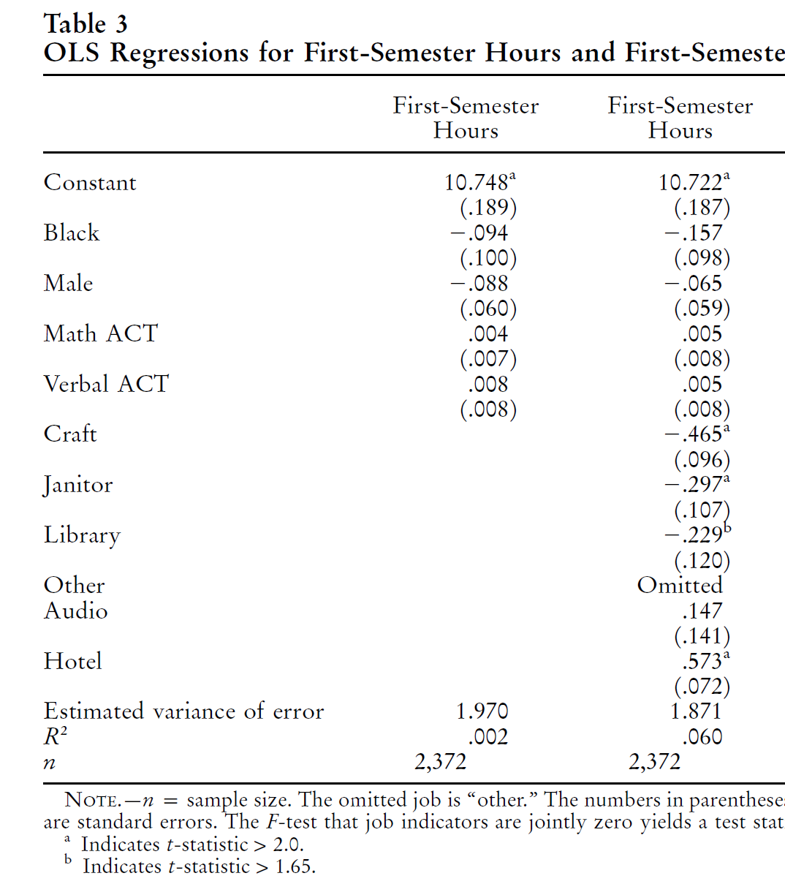
Next: Are the instruments relevant?
F-statistic testing null that job
type coefficients are jointly
equal to zero: 25.84
Conclusion: These are strong
Instruments!

Slide 39
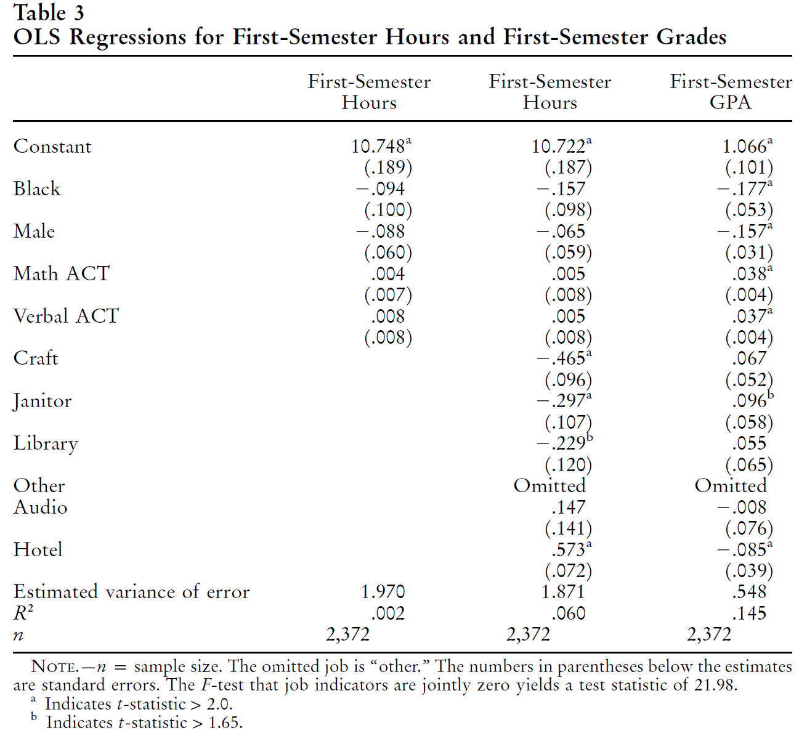
Question: What is the third column?

Slide 40
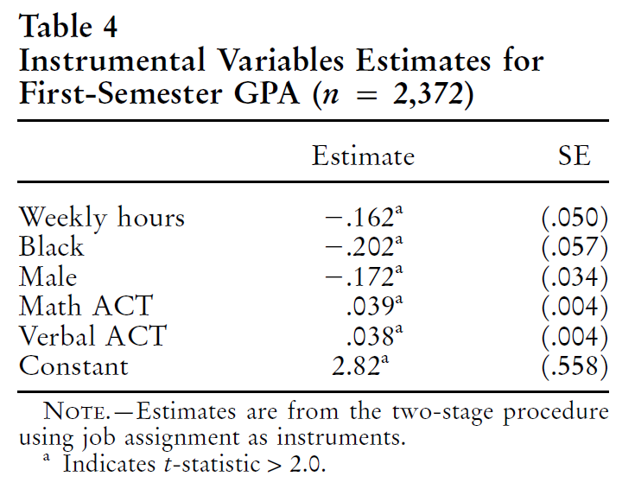
Next: 2SLS Estimates
Interpretation: Working one more hour reduces GPA by a statistically significant 0.162 points

Slide 41
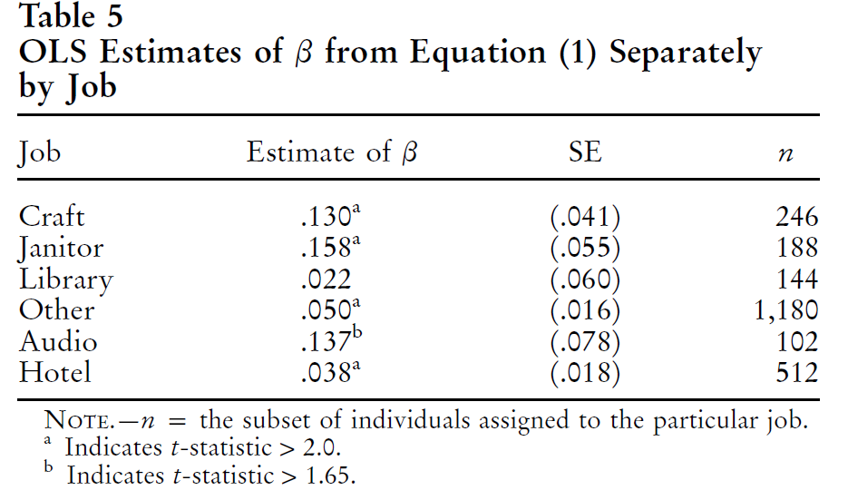
Recall: The purpose of IV is to identify only off of the “good” variation in the treatment variable
What would happen if we identified only off of the endogenous variation in the hours worked variable?
Note: A similar approach would have been to regress GPA on hours worked, and dummies for job assignment type

Slide 42
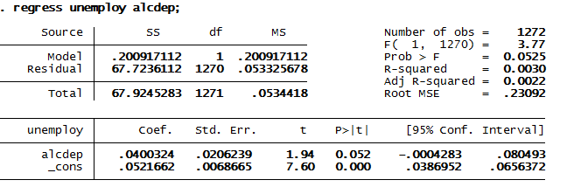
Final Thoughts: An Instrumental Variables Horror Story
Research Question: What is the effect of alcohol dependency on unemployment?
Why is this important? If alcoholism is a big driver of unemployment, it suggests a specific course of action different from others (e.g., training program)
Consider data from the 1988 National Health Interview Survey
Naïve regression of unemployment on alcohol dependency:
Interpretation: Alcohol-dependent people are 4 percentage points more likely to be unemployed

Slide 43
Interpretation: Alcohol-dependent people are 4 percentage points more likely to be unemployed
Identification Problem: Potential for omitted variable bias & reverse causation
Possibilities:
Alcohol dependency causes unemployment (a causes b)
Unemployment causes alcohol dependency (b causes a)
(e.g.) Depression causes unemployment, and depression causes alcohol dependency
or: Being unmotivated causes both unemployment and drinking
I wasn't born for diggin’ deep holes
I'm not made for pavin’ long roads
I ain’t cut out to climb high line poles
But I'm pretty good at drinkin’ beer
-Troy Jones, as performed by Billy Currington
Thus: We can be pretty sure that 4 percentage points is an overestimate
Solution? Find an instrument

Slide 44
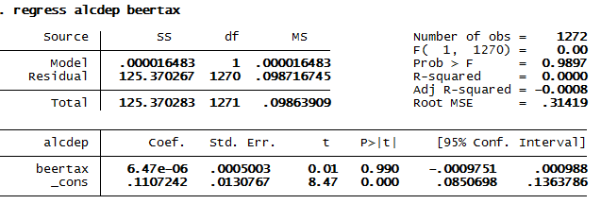
Consider the level of state beer taxes as an instrument. Two conditions?
It could plausibly be correlated with alcoholism
It could arguably only affect unemployment through alcoholism
(concern: what types of states pass higher alcohol taxes?)
First stage:
Note: It’s hard to find a weaker instrument than this

Slide 45
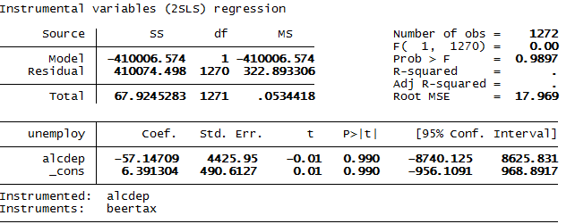
What if we were to estimate this with two-stage least squares?
Literal interpretation of the coefficient?
Being alcohol-dependent induces your probability of unemployment to be 5,700 percentage points lower

Slide 46
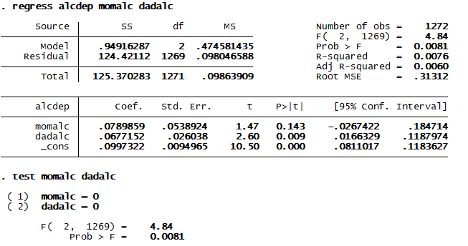
Now let’s consider 2 other instruments: whether one’s mother and father were alcohol-dependent
First stage:
Note: We’re still in the weak instrument world, but not as bad as with state alcohol taxes…

Slide 47
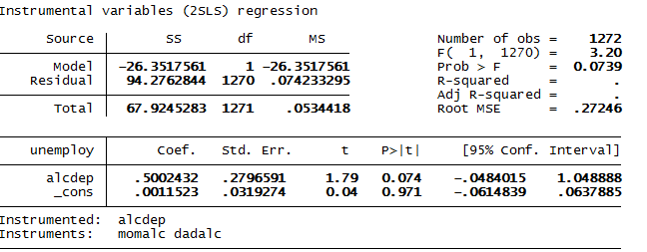
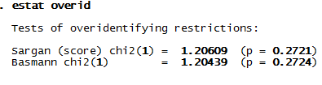
2SLS Estimates:
Interpretation?
My favorite part:

Slide 48
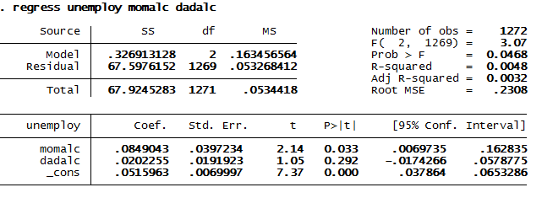
By comparison, look at the reduced form IV:
Estimates are much more sensible until you try to interpret this as the effect of own alcohol dependency on unemployment
Recall: 1st stage for mother’s alcohol dependency was 0.07
=> reweighed estimate is 1.21 (you’re 121 percentage points more likely to be unemployed if you are alcohol dependent)

Slide 49
Conclusions:
Tread very carefully when entering the world of IV; the only thing worse than not knowing a causal effect is thinking you do, and being wrong
Economists ought to “Do No Harm” when using econometrics, but it’s easy to violate that (and badly!) when using IV, and it’s not always transparent
Notes:
Always think about which direction bias works.

